Slide 1
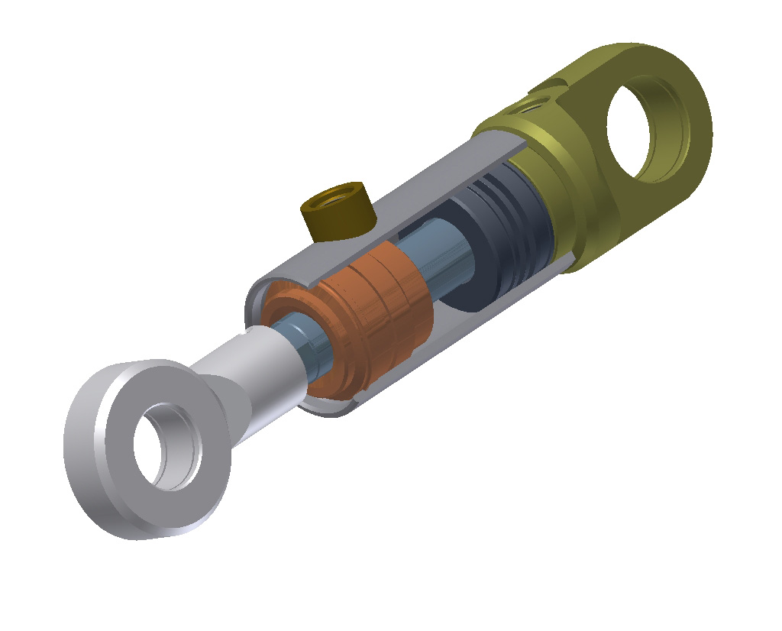

Slide 2
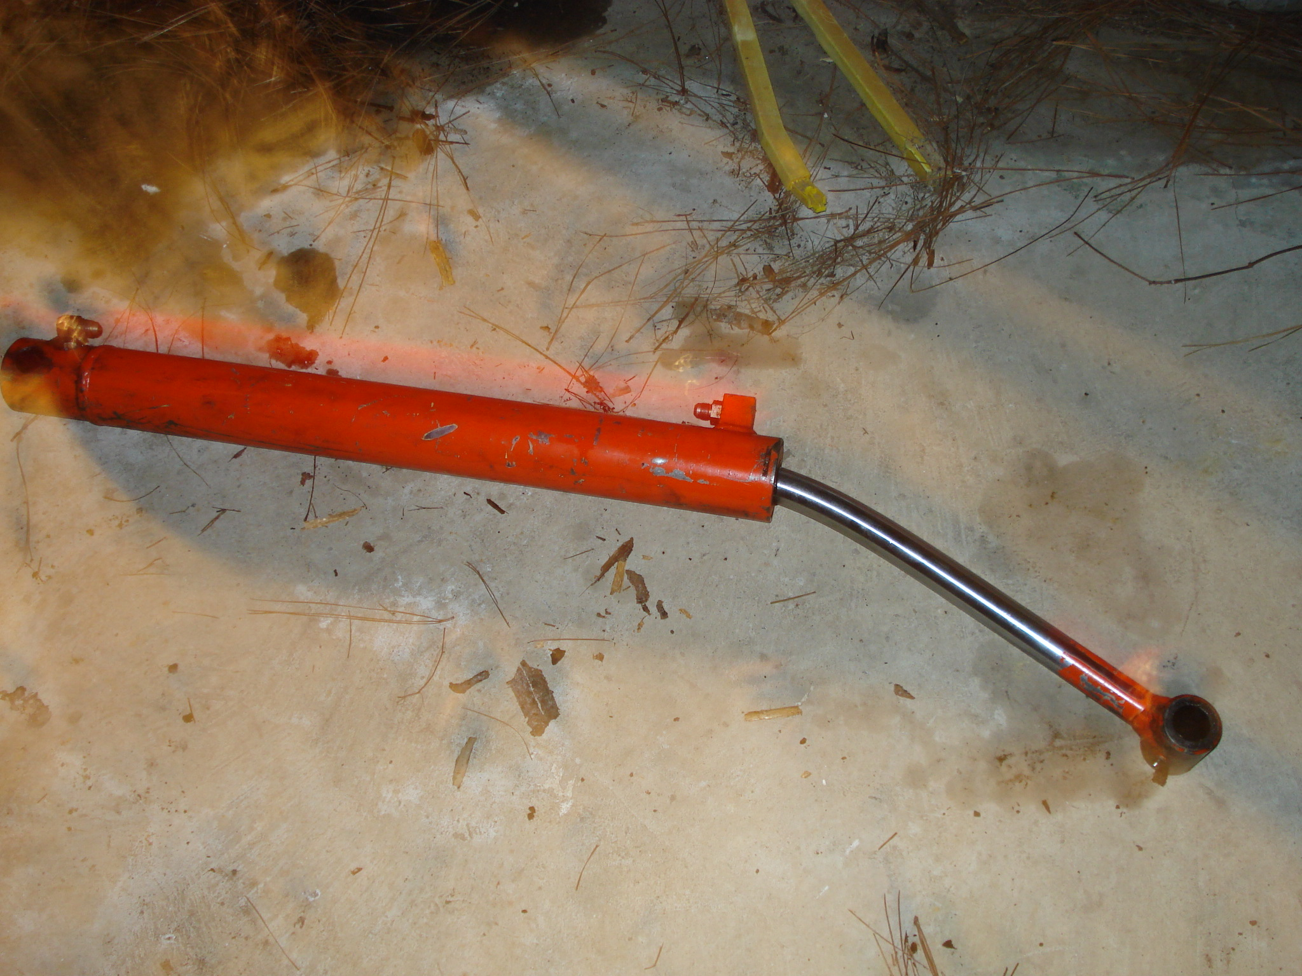
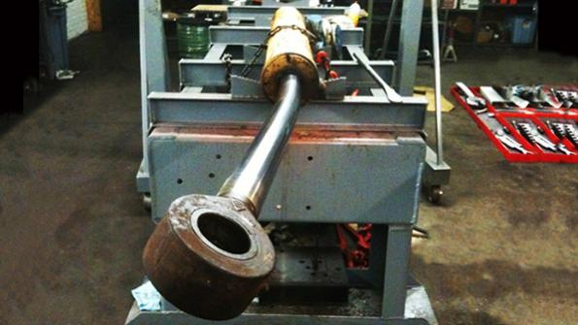
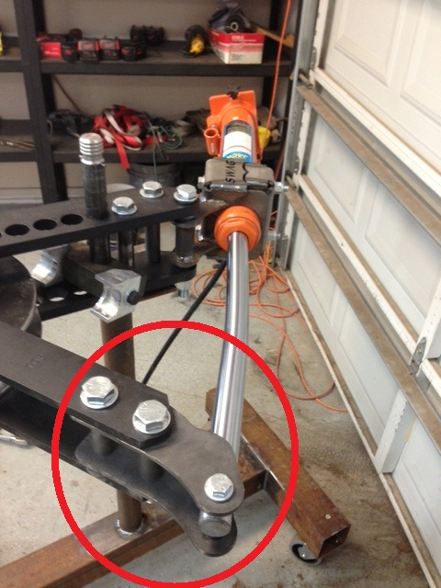
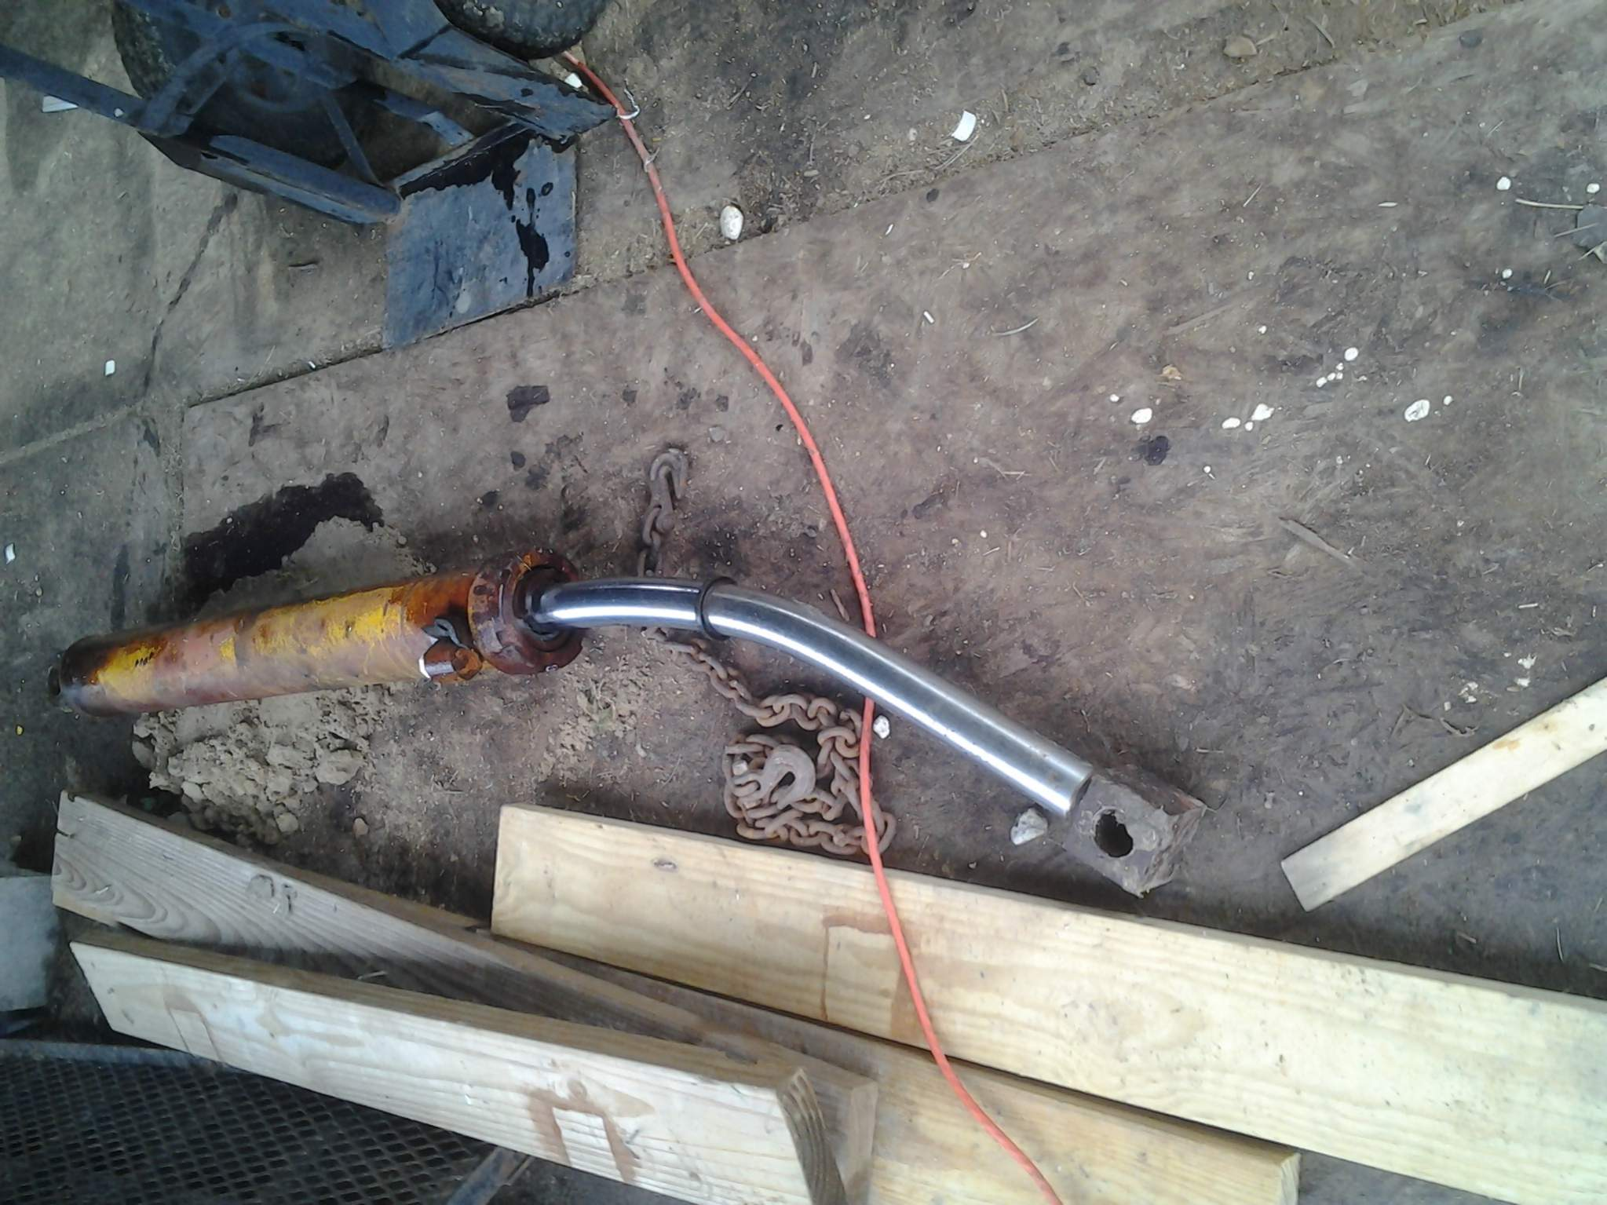
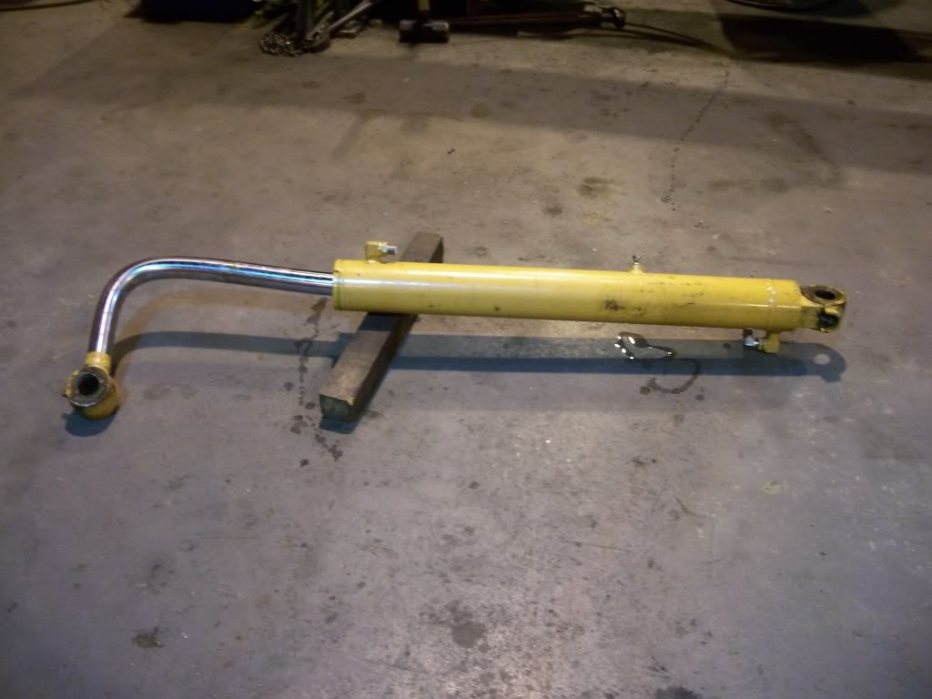
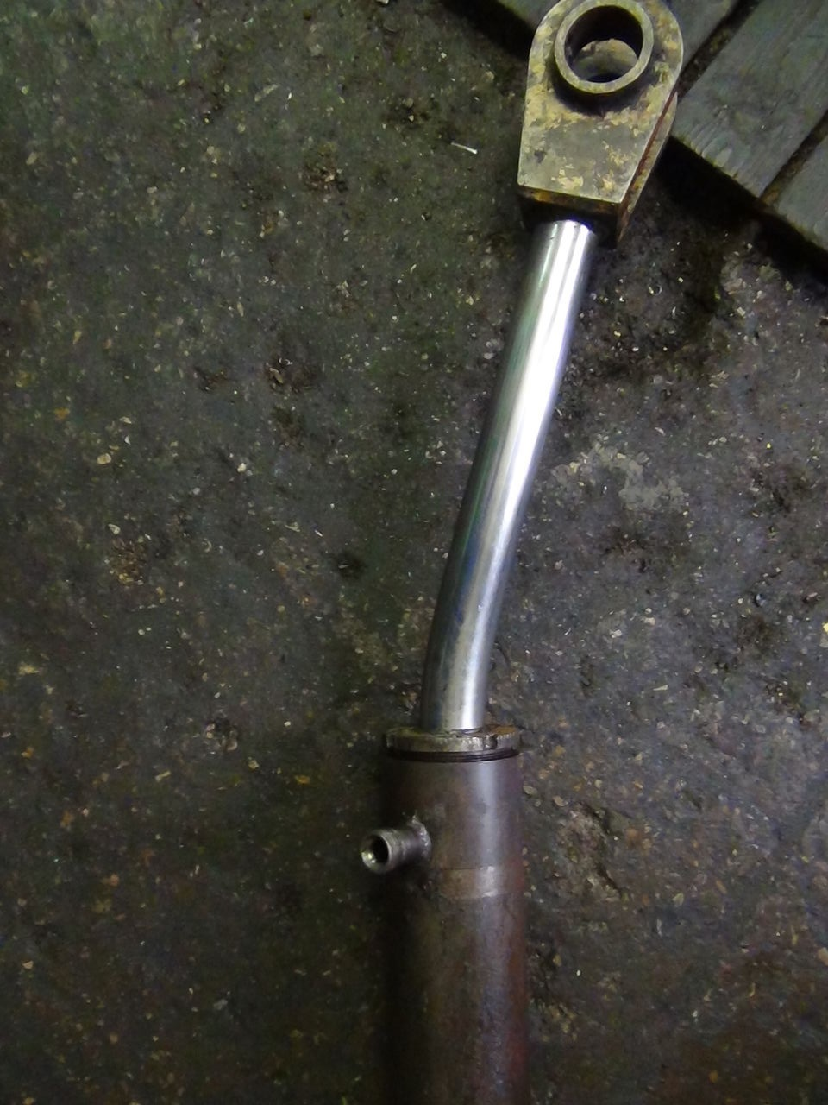

Slide 3
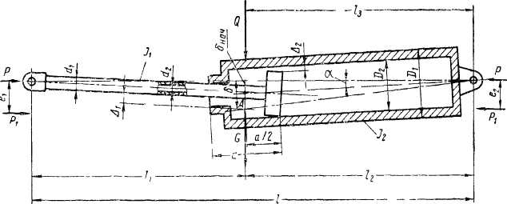

Slide 4
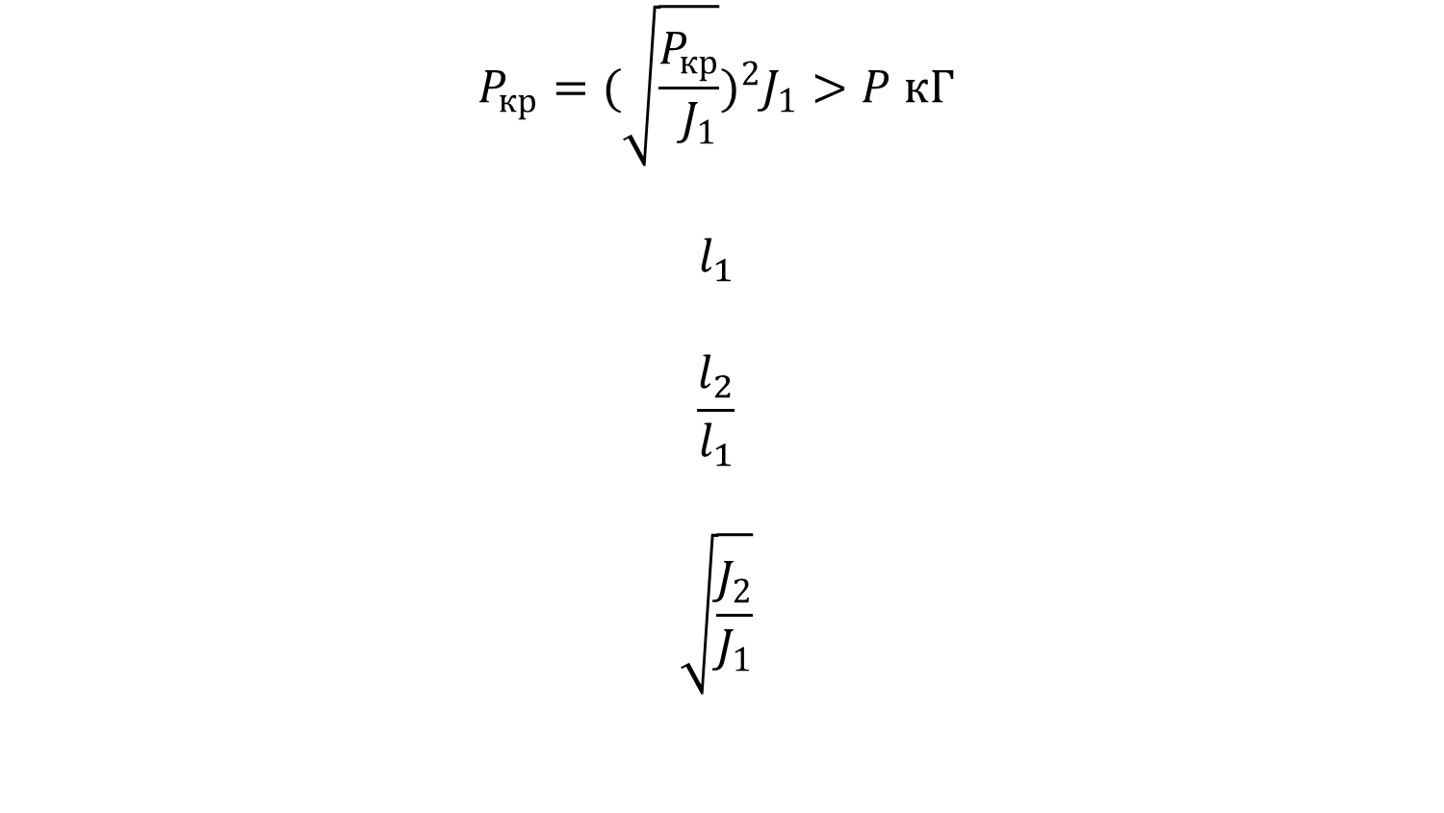
$$P_{кр}={(\sqrt{\frac{P_{кр}}{ J_{1}}})}^{2}J_{1}>P кГ$$
$$l_{1}$$
$$\frac{l_{2}}{l_{1}}$$
$$\sqrt{\frac{J_{2}}{J_{1}}}$$

Slide 5
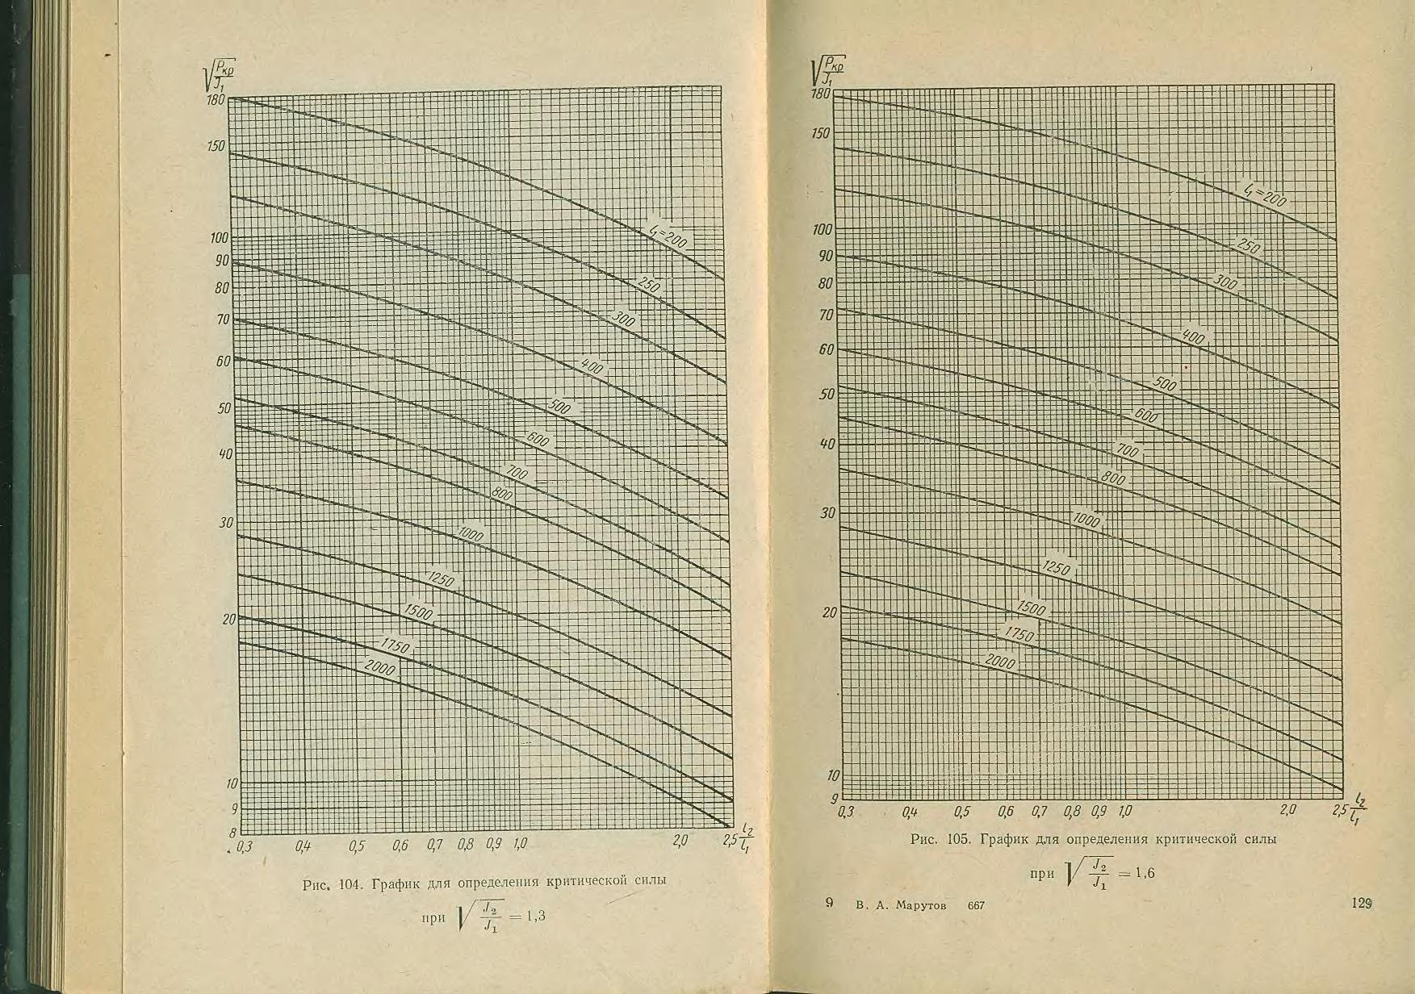

Slide 6
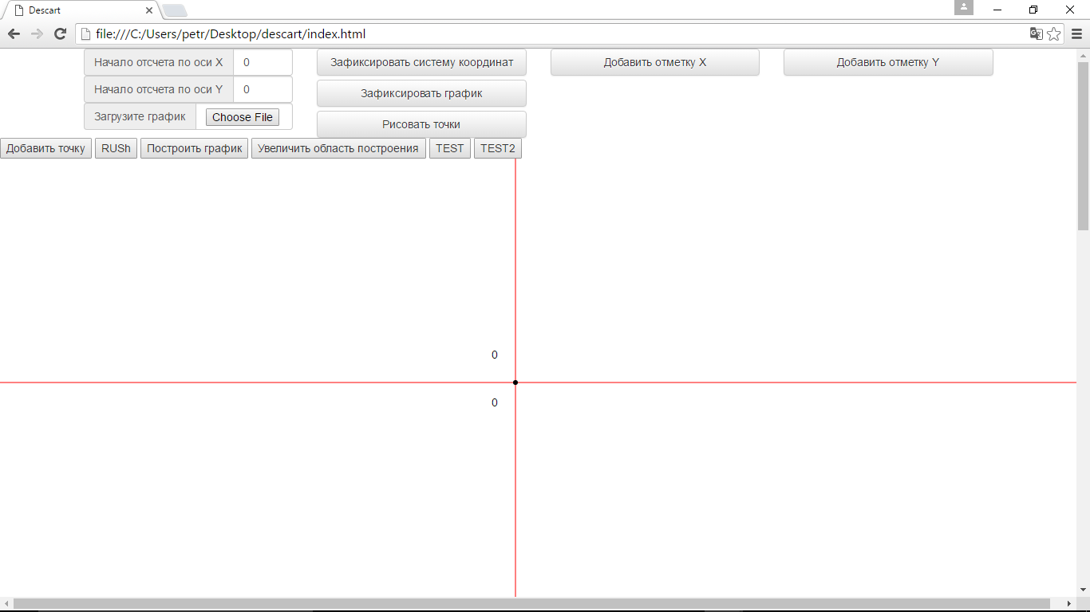

Slide 7
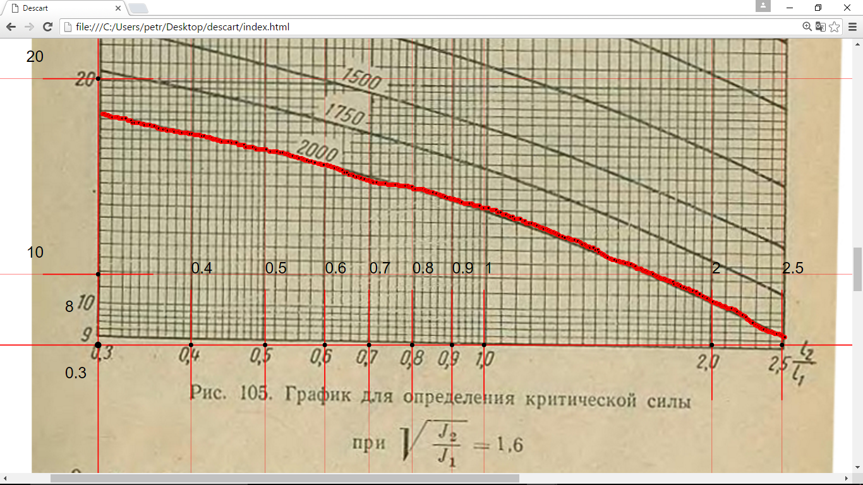

Slide 8
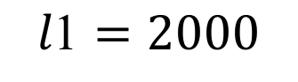
$$\text{l}\text{1}=2000$$

Slide 13
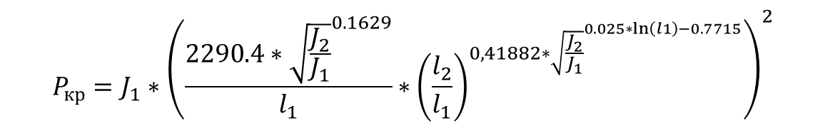
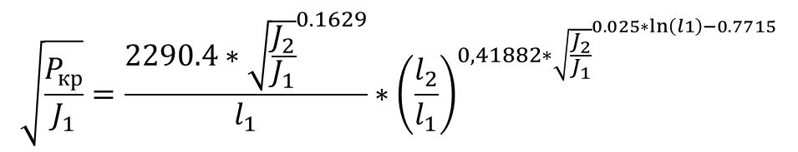
$$\sqrt{\frac{P_{кр}}{J_{1}}}=\frac{2290.4∗{\sqrt{\frac{J_{2}}{J_{1}}}}^{0.1629}}{l_{1}}∗{\left(\frac{l_{2}}{l_{1}}\right)}^{0,41882∗{\sqrt{\frac{J_{2}}{J_{1}}}}^{0.025∗\ln\left(l1\right)−0.7715}}$$
$$P_{кр}=J_{1}∗{\left(\frac{2290.4∗{\sqrt{\frac{J_{2}}{J_{1}}}}^{0.1629}}{l_{1}}∗{\left(\frac{l_{2}}{l_{1}}\right)}^{0,41882∗{\sqrt{\frac{J_{2}}{J_{1}}}}^{0.025∗\ln\left(l1\right)−0.7715}}\right)}^{2}$$

Slide 15
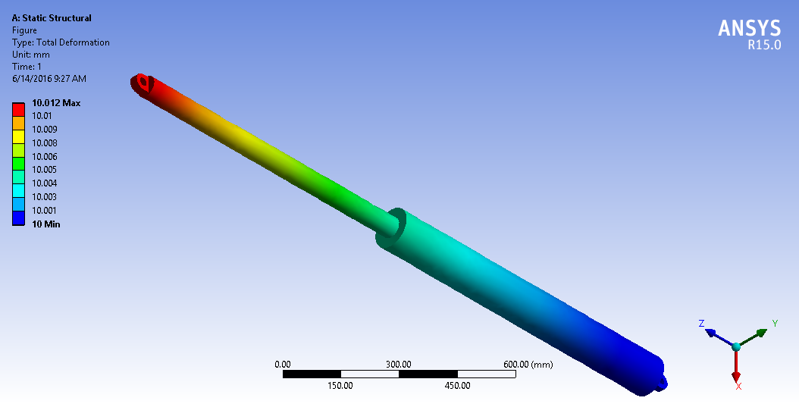

Slide 16
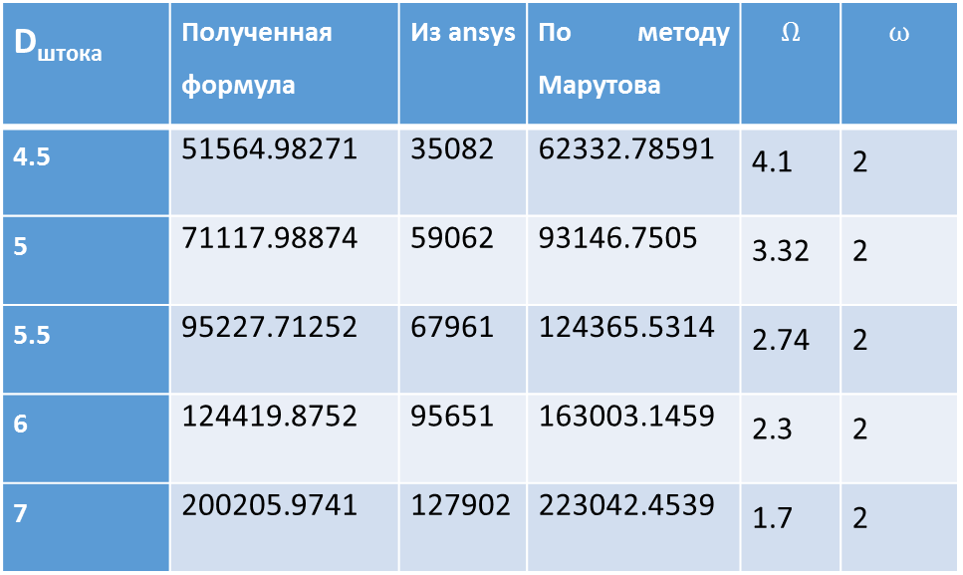
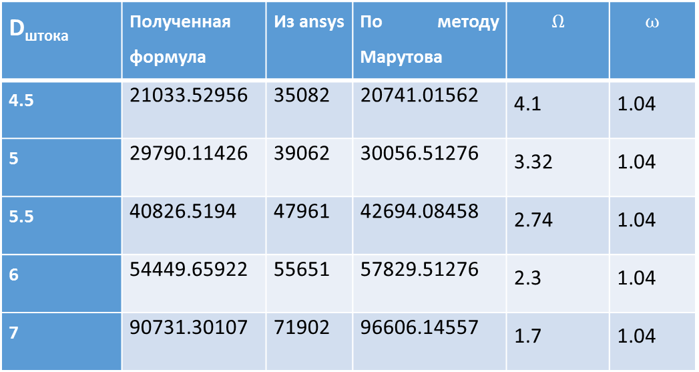
D_{штока} | Полученная формула | Из ansys | По методу Марутова | $$Ω$$ | $$ω$$
4.5 | 21033.52956 | 35082 | 20741.01562 | 4.1 | 1.04
5 | 29790.11426 | 39062 | 30056.51276 | 3.32 | 1.04
5.5 | 40826.5194 | 47961 | 42694.08458 | 2.74 | 1.04
6 | 54449.65922 | 55651 | 57829.51276 | 2.3 | 1.04
7 | 90731.30107 | 71902 | 96606.14557 | 1.7 | 1.04
D_{штока} | Полученная формула | Из ansys | По методу Марутова | $$Ω$$ | $$ω$$
4.5 | 51564.98271 | 35082 | 62332.78591 | 4.1 | 2
5 | 71117.98874 | 59062 | 93146.7505 | 3.32 | 2
5.5 | 95227.71252 | 67961 | 124365.5314 | 2.74 | 2
6 | 124419.8752 | 95651 | 163003.1459 | 2.3 | 2
7 | 200205.9741 | 127902 | 223042.4539 | 1.7 | 2

